Slide 1
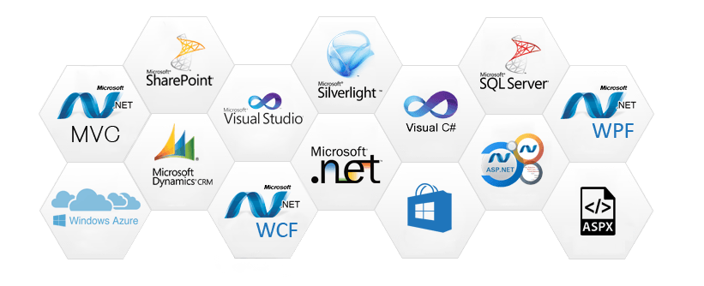
DOT NET TECHNOLOGIES CS205
by:-Mr. Chirag Joshi Assistant Professor DIT UNIVERSITY DEHRADUN

Slide 2
Course Objective
This course aims to provide the knowledge to understand the concepts and elementary use of .NET library such as development of windows application and website creation through ASP.NET. Students are also able to learn about the different validation and use of controls available in Visual Studio.

Slide 3
What is .NET ?
Microsoft .NET is a framework.
Provide common platform to execute or, rum the applications developed in various programming languages.
Developed by Microsoft.
Announces in July 2000.
The main intention was to bridge the gap in interoperability between services of various programming language.

Slide 4
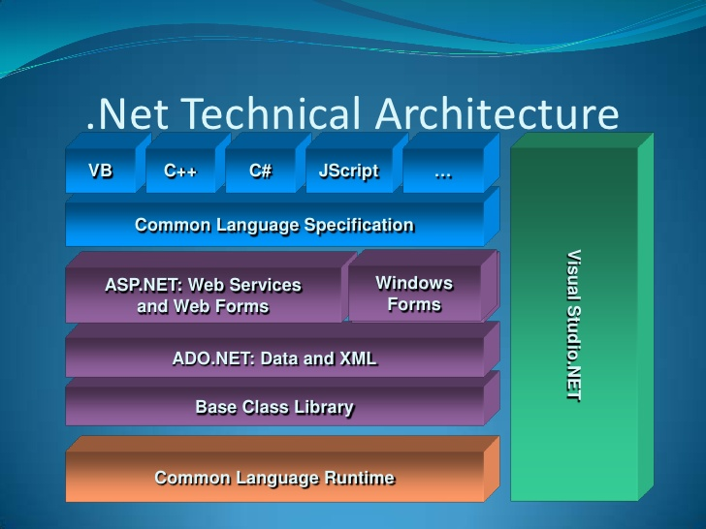
.NET FRAMEWORK

Slide 5
Features of .NET Framework
Interoperability support.
Rich Functionality out of the box.
Automatic memory management.
Easy development of web applications.
Multi-Language Support.
Common language runtime (CLR)
Base class library (BCL).
Common type system (CTS).
Simplified deployment (say good bye to DLL).
OOP Support
“ Self-hosted” Web Application
Portability

Slide 6

Why .NET?

Slide 7
Productive
.NET helps you develop high quality applications faster. Modern language constructs like generics, Language Integrated Query (LINQ), and asynchronous programming make developers productive.
Combined with the extensive class libraries, common APIs, multi-language support, and the powerful tooling provided by the Visual Studio family, .NET is the most productive platform for developers.

Slide 8
Any app, any platform
With .NET you can target any application type running on any platform. Developers can reuse skills and code across all of them in a familiar environment.
From mobile applications running on iOS, Android and Windows, to Enterprise server applications running on Windows Server and Linux, or high-scale microservices running in the cloud, .NET provides a solution for you.

Slide 9
Performance where it matters
.NET is fast. Really fast! That means applications provide better response times and require less compute power. StackOverflow serves 5.3M page views a day on just 9 servers.
The popular TechEmpower benchmark compares web application frameworks with tasks like JSON serialization, database access, and server side template rendering - .NET performs faster than any other popular framework.

Slide 10
Trusted and secure
.NET provides you with immediate security benefits via its managed runtime. A collection of services prevent critical issues like bad pointer manipulation or malicious attempts to alter compiled code. Microsoft takes security very seriously and releases updates quickly when threats are discovered

Slide 11
Large Ecosystem
Leverage the large .NET ecosystem by incorporating libraries from the NuGet package manager, our extensive partner network, and the Visual Studio Marketplace.

Slide 12
Open source
The .NET Foundation is an independent non-profit supporting the innovative, commercially-friendly, open source .NET ecosystem. Over 25,000 developers from over 1700 companies outside of Microsoft are contributing to .NET open source. In addition to the community and Microsoft, Technical Steering Group members, Google, JetBrains, Red Hat, Samsung and Unity are guiding the future of the .NET platform.

Slide 13
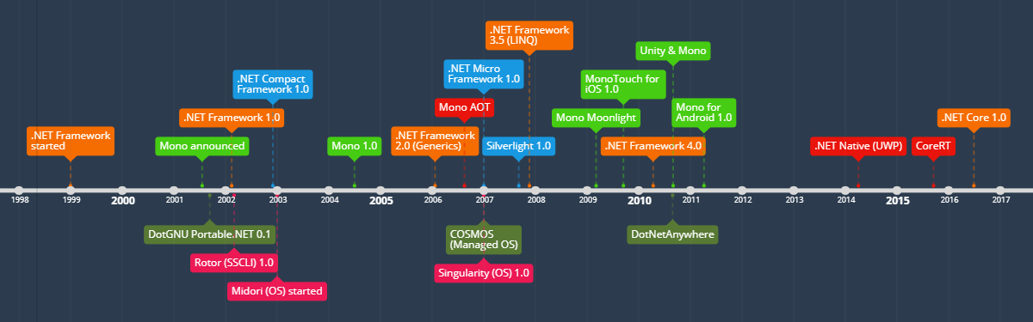
History of .NET Runtimes-Timeline

Slide 14
COMMON LANGUAGE SPECIFICATION(CLS)
Language interoperability is the ability of code to interact with code that is written using a different programming language.
Language interoperability can help maximize code reuse and, therefore, improve the efficiency of the development process.
To ensure that we can develop managed code that can be fully used by developers using any programming language, a set of language features and rules for using them called the Common Language Specification (CLS ) has been defined.

Slide 15
Common Type System(CTS)
The common type system defines how types are declared, used, and managed in the runtime, and is also an important part of the runtime's support for cross- language integration.
It establishes a framework that enables cross- language integration, type safety, and high performance code execution.
It provides an object-oriented model that supports the complete implementation of many programming languages.
It defines rules that languages must follow, which helps ensure that objects written in different languages can interact with each other. For example, if you have created a class in VB.NET, you can inherit from it in a C# program.

Slide 16
FRAMEWORK CLASS LIBRARY
Microsoft has divided the FCL into hierarchical namespaces. The FCL has about 100 namespaces in all.
The FCL has about 100 namespaces in all. Each namespace holds classes and other types that share a common purpose.
For example, much of the window manager portion of the Windows API is encapsulated in the S ystem.Windows.Forms namespace.

Slide 17
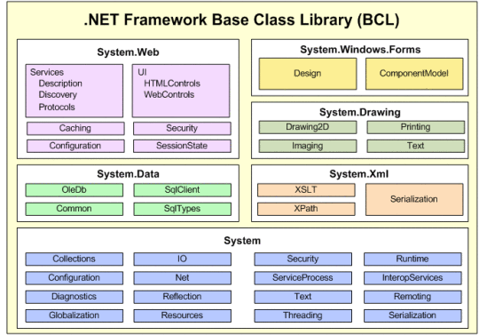

Slide 18
COMMON LANGUAGE RUNTIME(CLR)
The CLR is the platform on which applications are hosted and executed. The C LR also provides a set of services that applications can use to access various resources (like arrays, collections, operating system folders etc).
Since this runtime "manages" the execution of your code, code that works on the C LR is called as managed code. Any other code, you guessed it, is called unmanaged code.
When compilers emit code to run on the C LR, they do not emit machine language code. Rather, an intermediate language code is used called Microsoft Intermediate Language (MSIL).

Slide 19
COMMON LANGUAGE RUNTIME(CLR) Contd.
MSIL is like an object-oriented version o f assembly language and is platform independent. It has a rich set of instructions that enable efficient representation of the code.
When a code starts to execute, a process knowing as Just in Time Compilation (JIT) converts the MSIL code into the native processor instructions of the platform, which is then executed

Slide 20
PLATFORM INDEPENDENCE
First, it means that the same file containing byte code instructions can be placed on any platform; at runtime the final stage of compilation can then be easily accomplished so that the code will run on that particular platform.
In other words, by compiling to IL we obtain platform independence for .NET, in much the same way as compiling to Java byte code gives Java platform independence.

